Slide 1




HackOrbit 2025
JustMe

Slide 2

THEME & PROBLEM STATEMENT
Theme : Sustainability
Problem Statement: In our day-to-day lives, a lot of food goes to waste simply because we forget it’s there — hidden in the fridge, buried in the pantry, or left on the counter. This isn't just a personal loss, it's a global problem — with over 1.3 billion tons of food wasted every year. The issue isn’t just about food, it’s about wasting water, energy, money — and damaging our planet in the process. What’s missing is a simple, helpful tool to remind us before it’s too late.

Slide 3
PROPOSED SOLUTION
1. Build a simple web app where users can log food items with expiry dates
2. Track which items are about to expire and alert the user in time.
3. Suggest ways to use those items (like quick recipes)
4.Show how much food is saved vs. wasted using backend-generated charts.
5,Encourage mindful food habits with a user-friendly interface

Slide 4
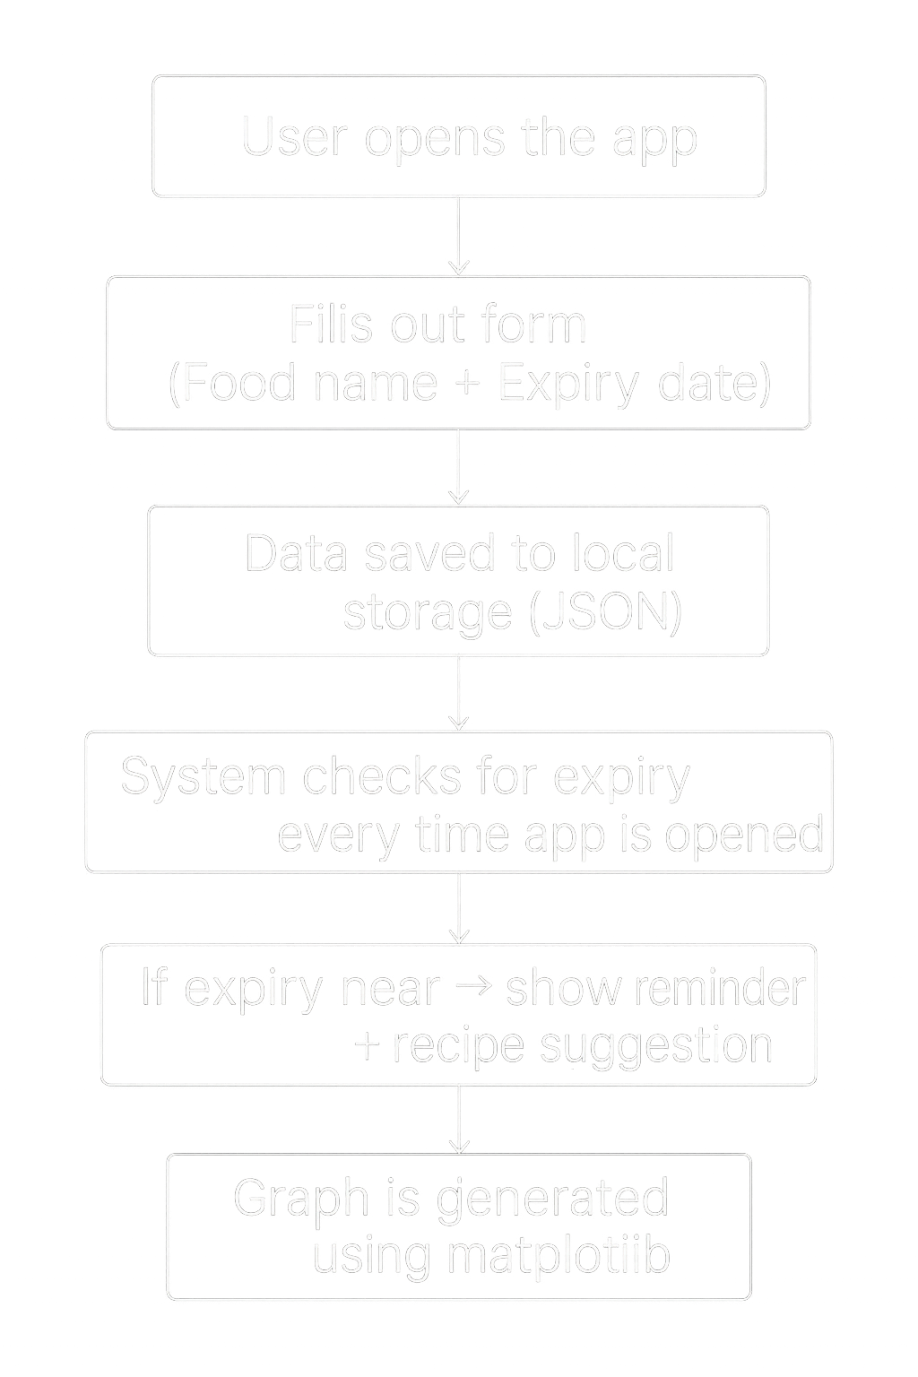
FLOWCHART / DIAGRAM

Slide 5
FLOWCHART / DIAGRAM
The process begins when the user opens the WasteNot app and enters the details of a food item, including its name, expiry date, and category.
📝 Once submitted, this data is stored locally in a JSON file — no internet or database required.
⏰ Every time the app runs, it checks for upcoming expiry dates by comparing the current date with the stored data.
🔔 If an item is close to expiry, the app displays a reminder notification and also suggests simple recipe ideas to help avoid waste.
✅ The user can then mark whether the food was used (saved) or thrown (wasted).
📊 Finally, the app uses Python’s matplotlib library to generate a clean pie or bar chart, helping the user visually track their food habits — highlighting how much food was saved or wasted over time.

Slide 6
FEATURES AND NOVELTY
Features:
Add food items with expiry dates manually
See a live list of what’s stored and when it’s expiring
Get reminders before food goes bad
See recipe suggestions to reduce waste
View a graph of saved vs. wasted food (using Python’s matplotlib)
Novelty:
Fully Python-based: No JavaScript or databases required
Built using Flask + HTML + JSON only
Designed to be beginner-friendly and solo-developer manageable
Promotes sustainability through practical daily usage

Slide 7
DRAWBACK AND SHOWSTOPPERS
Drawbacks:
Food has to be entered manually — no barcode or smart scanning
Local-only data storage — can't sync across devices
Limited real-time features like push notifications (without hosting)
Showstoppers:
If the user doesn’t update or remove expired items, the data may
become inaccurate
Hosting is optional, but without it the app runs only locally on one device

Slide 8
JustMe
Jhnavi Bhadkariya 8225993101

Slide 9
Thank you

